Slide 1
ATOMIC STRUCTURE
Draw the symbol for sodium include its atomic mass and atomic number (what do they tell us?)
Why do atoms contain equal number of protons and electrons?
Where are electrons and neutrons and protons found in an atom?
What are the charges and masses of electrons, protons and neutrons
 | Charge | Mass
Proton
Neutron
Electron
35
17
37
17
[H] Chlorine has 2 isotopes, 75% is Cl and 25% is Cl . Calculate the relative atomic mass of Chlorine. Give your answer to 1dp.
What is an isotope?
How are the chemical and physical properties of isotopes different?
Draw the electronic configuration for argon
How has the Dalton model of the atom changed over time?
Calculate the number of protons, neutrons and electrons these atoms have:
Draw and label the nuclear model of the atom
9
4
P=
E=
N=
Be
39
19
P=
E=
N=
K

Slide 2
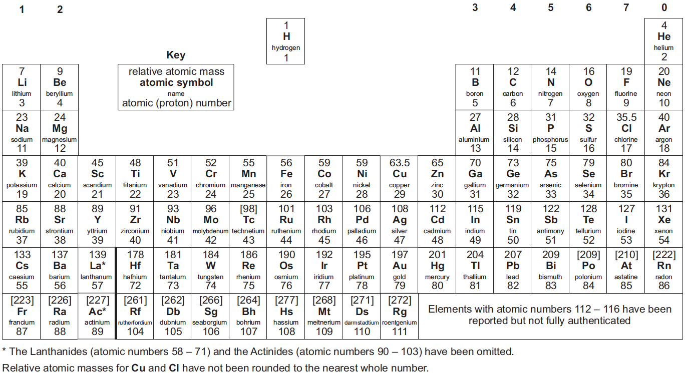
THE PERIODIC TABLE
Describe the ways in which the modern periodic table is ordered:
1.
2.
3.
Explain the meaning of atomic number and why it determines the position of an element in the periodic table
Describe the ways in which Mendeleev ordered his table of elements
What was so different about the way he order the table compared to other scientists?
Use two different colours to distinguish between metals and non-metals on the periodic table
Draw and write the electron configuration of Calcium
Explain how the electronic configuration of an element is related to its position in the periodic table

Slide 3
IONIC BONDING
Use a diagram to describe how Potassium (K) Chloride (Cl) is formed:
What is an ion?
How many protons, neutrons and electrons do the following ions have?
Li⁺
F⁻
O²⁻
Al³⁺
Give the electronic arrangement and charge of:
A Sodium ion
A Chloride ion
An Oxide ion
A Boron ion
Describe what happens when Oxygen and Magnesium react to form an ionic bond
What is an ionic bond and how is it formed?
Complete the table by giving the name and formula of the ionic compound formed
Cations |  | Anions
 |  | Chloride Cl⁻ | Oxide O²⁻ | Iodide I⁻ | Hydroxide OH⁻
 | Sodium Na⁺ | NaCl Sodium Chloride
 | Barium Ba²⁺ |  |  |  | Ba(OH)₂ Barium hydroxide
 | Calcium Ca²⁺ |  | CaO Calcium oxide
 | Aluminium Al³⁺
Explain why a Calcium ion has a charge of 2+

Slide 4
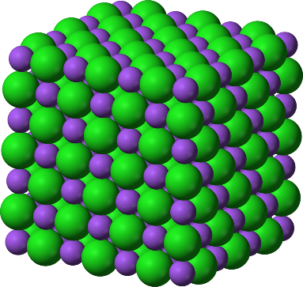
IONIC COMPOUNDS
Which types of elements carry out ionic bonding?
Label the ions in this giant ionic lattice of Sodium Chloride (NaCl). Include which is the anion and cation and the charge on each ion
What forces of attraction hold the ions together in a giant ionic lattice?
Compound | Melting point (⁰C) | Soluble in water? | Conducts electricity when molten
A | 2072 | No | Yes
B | 191 | No | No
C | 782 | Yes | Yes
D | 605 | Yes | Yes
E | 150 | Yes | No
Why can a solid ionic compound not conduct electricity?
Why can a molten or dissolved ionic compound conduct electricity?
Identify the compounds from the table that have ionic bonding and explain your reasoning
Why do ionic compounds have high melting and boiling points?
[H] Why does Magnesium Oxide (MgO) have a higher melting and boiling point than Sodium Chloride (NaCl)?
How do you know the other compounds do not have ionic bonding?
Difficult, compound, gaining, ionic, losing, new, noble
When two different elements react together they make a _________ substance called a_________. It is _________ to separate the elements after the reaction. Some atoms react by _________ or _________ electrons. We call this _________ bonding. When atoms react in this way they get the electronic structure of a _________ gas.
Notes:
4

Slide 5
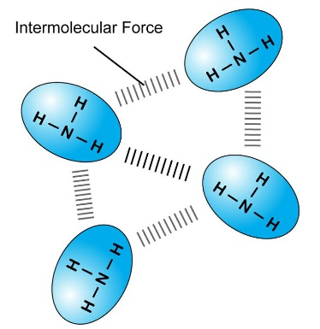
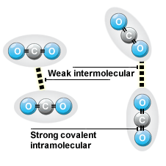
COVALENT BONDING AND SIMPLE COLVALENT MOLECULES
Complete the electron shell diagrams to represent the bonding in the following molecules:
Hydrogen (H₂)
Hydrogen Chloride (HCl)
Oxygen (O₂)
Water (H₂O)
The majority of covalent molecules are simple covalent molecules like the ones of the left hand side
The diagrams below show the intermolecular forces between simple covalent molecules
Explain in terms of intermolecular forces why simple covalent molecules have low melting and boiling points
Explain why simple covalent molecules do not conduct electricity
Complete the electron shell diagram to represent the bonding in methane (CH₄)
Do you think methane is a solid, liquid or gas at room temperature?
Why?
Covalent, difficult, compound, new, noble
When two different elements react together they make a __________ substance called a_________. It is __________ to separate the elements after the reaction. Some atoms react by sharing electrons. We call this __________ bonding. When atoms react in this way they get the electronic structure of a __________ gas.
Notes:
5

Slide 6
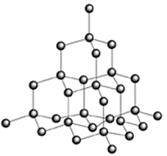
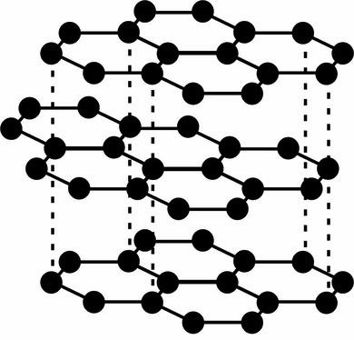
ALLOTROPES OF CARBON
The diagram below shows the structure of graphite
Describe the structure of graphite
Why is graphite used to make electrodes?
Why is graphite used to make lubricants?
The diagram below shows the structure of diamond
Describe the structure of diamond
Why is diamond used in cutting tools?
How are diamond and graphite similar?
How are diamond and graphite different?
Describe the differences between simple covalent molecules and giant covalent molecules
Describe the structure of a polymer
Describe the structure of a fullerene
Describe the structure of graphene
Notes:
6

Slide 7
ACIDS
Complete the general equation for the reaction of a metal with acid:
Acid + metal → ________ + _________
Complete the general equation for the reaction of an acid and an alkali:
Acid + alkali → __________ + __________
Complete the general equation for the reaction of an acid and a carbonate:
Acid + carbonate → __________ + __________ + __________
A neutral solution has a pH of ____ . An acidic solution has a pH lower than ____ and an alkali solution has a pH higher than ____,
As you move once along the pH scale the ____________ ion concentration changes by a factor of ______ .
What are the similarities and differences between bases and alkalis?
Describe what the pH scale tells us about different substances
List the general rules which describe the solubility of common substances in water:
What is the chemical test for hydrogen?
What is the chemical test for carbon dioxide?
[H] What is the difference between a strong and a weak acid?
What effect do acids and alkalis have on litmus paper, methyl orange and phenolphthalein?
Describe how to make a pure, dry salt from an acid and an alkali
[H] What is the difference between a dilute and a concentrated acid?
Draw a diagram to help you explain
OH⁻ pH scale H⁺ Neutralise Alkali
Acids are substances which produce ___ ions when we add them to water.
Bases are substances that will __________ acids.
An ______ is a soluble base. Alkalis produce ___ ions when we add them to water.
We can use the ________ to show how acidic or alkaline a solution is.
Notes:
7

Slide 8
CALCULATIONS INCLUDING MASSES
Calculate the relative formula mass (M_{r}) of:
Copper oxide (CuO).
Relative atomic masses: O = 16, Cu = 64
Sulfuric acid (H₂SO₄).
Relative atomic masses: H = 1, S = 32, O = 16
Ammonia (NH₃).
Relative atomic masses: N = 14, H = 1
14.3g of an oxide of copper contained 12.7g of copper
Calculate the empirical formula of this oxide
Relative atomic masses: Cu = 63.5, O = 16
Cu O
0.50g of sodium chloride is mixed with water to make 25cm³ of solution.
Calculate the mass of sodium chloride in 10cm³ of solution
Mass:
Mr:
Moles:
Ratio:
Empirical formula:
In an experiment to determine the empirical formula of magnesium oxide, 0.63g of magnesium combined with 0.42g of oxygen. Calculate the empirical formula of the magnesium oxide. Relative atomic masses: Mg = 24, O = 16
[H] 34.5g of nitrogen dioxide is provided in a sample.
Calculate the number of nitrogen dioxide molecules, NO₂, in this sample.
(relative atomic masses: O = 16.0, N = 14; Avogadro constant = 6.02 × 10²³ mol^{–1})
Calculate the concentration in g/dm³ for:
50 g of sodium chloride in 2.5 dm³ of water
1.8g of sodium carbonate in 862cm³ of water
Calculate the mass of potassium bromide (KBr) dissolved in 200 cm³ of water with a concentration of 1.5g/dm³
When calcium carbonate is heated it thermally decomposes into calcium oxide and carbon dioxide.
CaCO₃ → CaO + CO₂
Calculate the maximum mass of calcium oxide that could be formed from 1.5 g of calcium carbonate.
(relative masses: Ca = 40, C = 12, O = 16)

Slide 9
STATES OF MATTER
Draw a diagram to represent the arrangement of particles in a solid
Describe the arrangement, movement and the relative energy of the particles in a solid
What is the name of the process where a solid turns into a liquid?
What happens to the arrangement, movement and energy of the particles during this conversion?
Draw a diagram to represent the arrangement of particles in a liquid
Describe the arrangement, movement and the relative energy of the particles in a liquid
What is the name of the process where a liquid turns into a gas?
What happens to the arrangement, movement and energy of the particles during this conversion?
Draw a diagram to represent the arrangement of particles in a gas
Describe the arrangement, movement and the relative energy of the particles in a gas
What is the name of the process where a gas turns into a liquid?
What happens to the arrangement, movement and energy of the particles during this conversion?
Notes:
9

Slide 10
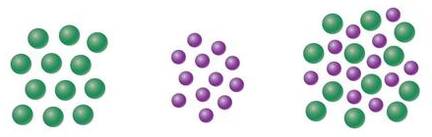
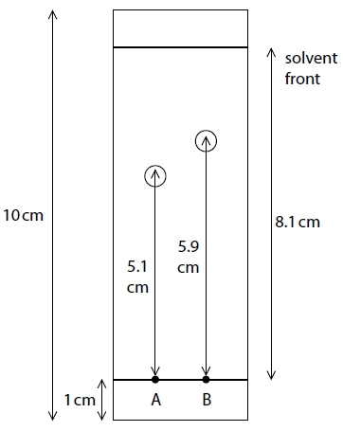
METHODS OF SEPARATING AND PURIFYING SUBSTANCES
Use the diagrams to help you describe the difference between a pure substance and a mixture
A pure substance and a mixture were melted. The data obtained is shown below.
Which line shows the melting of a pure substance, and which shows the melting of a mixture?
How did you decide?
Describe the different stages in the purification of water:
Sedimentation
Filtration
Chlorination
Describe using diagrams how to separate an insoluble solid from a liquid using filtration
Why would this method not work if the solid was soluble?
Describe using diagrams how to separate two or more liquids using fractional distillation
Describe how seawater can be made potable
Give the equation to calculate R_{f} values:
Calculate the R_{f} values of components A and B
A:
B:
Temperature
Time
Attracted, separation, rates, mobile, stationary,
Chromatography is the _________ of mixtures of soluble substances. The mobile phase is the _________ and the stationary phase is the _________ .
The different substances in the mixture are all _________ to the mobile phase and the stationary phase by different amounts. This means the substance move at different _________ up the paper.
Notes:
10

Slide 11
ELECTROLYTIC PROCESSES
What is electrolysis?
What do we call the substance that is broken down during electrolysis
What is the positive electrode called?
What is the negative electrode called?
Label a diagram showing the electrolysis of molten copper bromide (CuBr₂)
P a N i c
Describe the movement of ions and electrons at each electrode when potassium iodide (KI) solution is electrolysed
Give a half equation for the reaction at the cathode:
Give a half equation for the reaction at the anode:
Positive
Anode
What does OILRIG stand for?
O
I
L
R
I
G
What is the rule for determining which element is formed at the cathode?
What is the rule for determining which element is formed at the anode?
Describe how to purify copper with electrolysis
Complete the table
Ionic substance in solution | Element formed at cathode | Element formed at anode
NaCl₂ | Hydrogen | Chlorine
CuCl₂
LiBr
H₂SO₄
CuSO₄
Why can solid ionic compounds not be electrolysed but molten ionic compounds can?
Notes:
11

Slide 12
OBTAINING AND USING METALS
Potassium
Sodium
Calcium
Magnesium
Aluminium
Carbon
Zinc
Iron
Copper
Silver
Gold
Complete the following word equations:
Copper oxide + Zinc → ___________ + ____________
What happened and why?
Aluminium oxide + Iron → ___________ + ____________
What happened and why?
Less reactive metals are displaced by carbon. Complete the equations below
Copper Oxide + Carbon → ______________ + ______________
CuO + C → _____ + _____
What has been oxidised?
What has been reduced?
Explain why carbon can reduce zinc oxide but cannot reduce aluminium oxide
How is aluminium extracted from aluminium oxide?
You have access to water, acid and a selection of metals. How do you determine the relative reactivity of the metals?
What is meant by oxidation?
What is meant by reduction?
Describe how metals are extracted with phytoextraction
Outline the advantages of recycling metals
What is a product life-cycle assessment?
Describe how metals are extracted with bioleaching

Slide 13
REVERSIBLE REACTIONS AND EQUILIBRIA
What is a reversible reactions?
Give the symbol that represents a reversible reaction:
What is a dynamic equilibrium?
[H] Describe how the following conditions affect a dynamic equilibrium:
Increasing the temperature:
Decreasing the temperature
Increasing the pressure:
Decreasing the pressure:
Increasing the concentration of reactants:
Increasing the concentration of products:
[H] The formation of methanol from carbon monoxide and hydrogen is a reversible reaction that is exothermic in the forward direction
CO _{(g)} + 2H₂ _{(g)} CH₃OH _{(g)}
Explain the effect on the position of equilibrium of increasing:
Temperature
Pressure
Carbon monoxide concentration
What is the Haber process?
Give the word equation for this reaction:
Give the balanced symbol equation for the reaction:
Where are the raw materials sourced from?
List the reaction conditions needed for the reaction
Notes:
13

Slide 14
GROUPS IN THE PERIODIC TABLE
Complete and balance the following chemical equations and state what has been oxidised and what has been reduced:
NaCl + F₂ → _____ + _____
LiBr + I₂ → _____ + _____
KBr + Cl₂ → _____ + _____
Explain in term of electronic structure why Fluorine is the most reactive element in group 7
Explain in term of electronic structure why Francium is the most reactive element in group 1
Describe the chemical test for Chlorine gas
Group 0:
Describe the physical properties:
Describe and explain the chemical properties:
Group 1:
Describe the properties:
Describe the reactions with water:
Describe the properties of halogen halides
Group 7:
Describe the physical properties:

Slide 15
RATES OF REACTION
What do we mean by ‘rate of reaction’?
What factors affect the rate of a reaction?
1.
2.
3.
4.
5.
What must happen for a reaction to occur?
1.
2.
What is the smallest amount of energy that must be overcome for a reaction to occur?
Explain the effect of concentration on the rate of reaction
Draw diagrams to represent it:
Explain the effect of temperature on the rate of reaction
Draw diagrams to represent it:
Low conc^{n}
High conc^{n}
Low temp
High temp
Why does increasing the pressure increase the rate of reaction?
What do catalysts do?
What happens to them during a reaction?
Explain the effect of surface area on the rate of reaction
Draw diagrams to represent it:
Energy activation collide frequently minimum
Particles can react with each other only when they __________ with sufficient _________ . Reaction rates increase when collisions are more energetic and/or happen more __________ . The __________ amount of energy needed for particles to react is known as the ___________ energy.
Small surface area
Large surface area

Slide 16
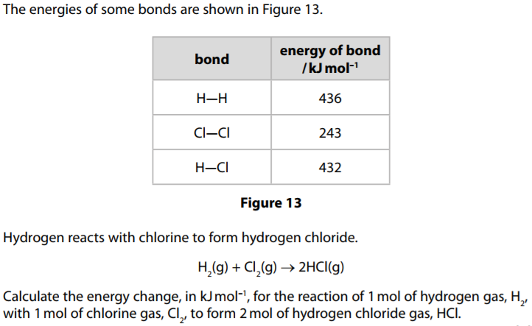
HEAT ENERGY CHANGES IN CHEMICAL REACTIONS
What is an exothermic change?
What is an endothermic change?
Breaking bonds is __________
Making bonds is ___________
Overall a heat energy change for a reactions is exothermic if:
Overall a heat energy change for a reaction is endothermic if:
Sketch an energy change graph for each of the following and explain the energy changes taking place:
Endothermic
Exothermic:
On both diagrams
Label the activation energy
Draw and label the reaction pathway if a catalyst was used
Hydrogen peroxide decomposes as shown:
2 H₂O₂ → O₂ + 2 H₂O
2 H-O-O-H → O=O + 2 H-O-H
Calculate the energy change for the reaction
Give an example of an exothermic reaction
Give an example of an endothermic reaction
Bond | Energy (kJ)
H-O | 464
O-O | 146
O=O | 498
kJmol⁻¹

Slide 17
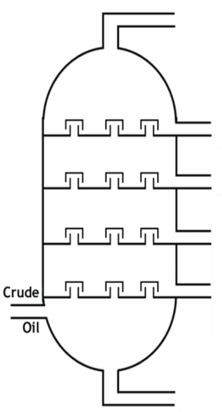
FUELS
Give the uses of the following fractions:
Gases
Petrol
Kerosene
Diesel oil
Fuel oil
Bitumen
Complete and balance the word and symbol equation which summarises the combustion of hydrocarbons
Hydrocarbon + Oxygen → ______________ + _____________
Methane + Oxygen → ______________ + ______________
CH₄ + O₂ → _________ + __________
What are the advantages and disadvantages of using hydrogen as a fuel?
What is incomplete combustion and why is it a problem?
Why is carbon monoxide described as a toxic gas?
Label the diagram of the fraction column. Use the following phrases to help you:
Small molecules collected
Large molecules collected
Hottest temperatures
Coolest temperatures
Gases
Liquids
Explain how burning fossil fuels can lead to acid rain
Outline the problems associated with acid rain
How are nitrogen oxides produced in car engines?
What is cracking and why is it necessary?
The shorter the hydrocarbon chain:
The _____________ the boiling point.
The _____________ ease of ignition.
The _____________ viscous.
Carbon Distillation Hydrocarbons Hydrogens Mixture
Crude oil is a _______ of compounds. Many of these only contain atoms of ________ and ________ . They are called ___________ . The compounds in crude oil can be separated using ___________ .
Notes:
17

Slide 18
EARTH AND ATMOSPHERIC SCIENCE
Gases produced by volcanic activity formed the early Earth’s atmosphere.
What was the composition of the Earth’s early atmosphere?
What happened to the water vapour in the atmosphere as the Earth cooled?
Describe the chemical test for oxygen
Name the gases in the Earth’s atmosphere that contribute to global warming
Explain what the greenhouse effect is and describe how these gases contribute to it
What caused the levels of oxygen in the atmosphere to increase?
How has the amount of carbon dioxide in the atmosphere reduced since the levels in the early atmosphere?
1.
2.
What evidence is there that humans have caused climate change?
Why do some question the certainty of this?
Describe the potential effects on the climate of increased levels of carbon dioxide and methane
How have humans increased the levels of carbon dioxide and methane in the atmosphere?
Notes:
18

